Slide 1

Project Title:
Cloud Based Daily Expense Visualization Dashboard using Microsoft Azure
TEAM MEMBERS:-
K.Lakshmipriya-2320030453
J.Sree Divya-2320030376
P.Vishnu Vardhan-2320030439

Slide 2
Introduction
This project develops a Cloud Based Daily Expense Visualization Dashboard to help users track and manage their daily spending easily. Manual expense tracking is often time-consuming and difficult to analyze. The system stores expense data securely in the cloud using Microsoft Azure and presents it through visual dashboards. Users can view their spending patterns in charts and graphs, making financial management simpler and more effective.

Slide 3
Objectives
To develop a cloud-based system for tracking daily expenses.
To store expense data securely using Microsoft Azure.
To provide real-time access and easy expense entry for users.
To visualize spending patterns through interactive dashboards.
To help users manage budgets and make better financial decisions.
To develop a web-based platform for easy expense management

Slide 4
Technologies Used
Microsoft Azure (Cloud platform)
Azure SQL Database (Data storage)
Python Flask (Backend API)
Power BI (Data visualization)
HTML / Web Form (User input)

Slide 5
Literature Survey
Many existing solutions are available for expense tracking, such as mobile expense management apps and spreadsheet-based systems. These tools allow users to record daily expenses but often lack advanced data analysis and real-time visualization.
Research shows that cloud-based systems improve data accessibility, storage reliability, and scalability. Data visualization tools like dashboards help users understand spending patterns more effectively.
However, most existing solutions do not fully integrate cloud storage with real-time visualization in a simple and centralized platform. This creates the need for an efficient cloud-based expense tracking system with interactive dashboards.

Slide 6
Methodology
User enters expense
User fills a simple web form (date, category, amount, description).
Web app sends data to backend
The form sends data to a Python Flask API.
Data stored in Azure cloud database
Flask stores the expense securely in Azure SQL Database.
Power BI reads data from database
Power BI connects to Azure SQL and fetches stored data.
Dashboard shows visual insights
Charts display daily, monthly, and category-wise expenses.

Slide 7
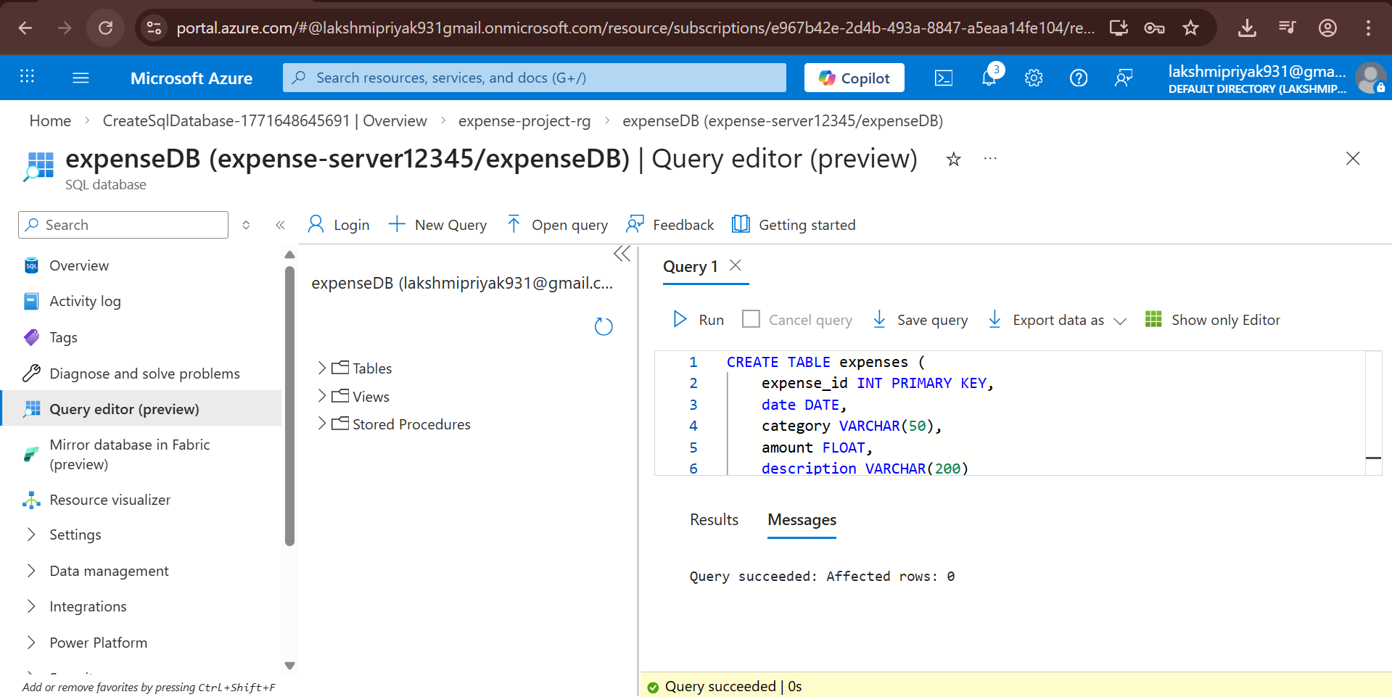
Azure Database Setup and Table creation

Slide 8
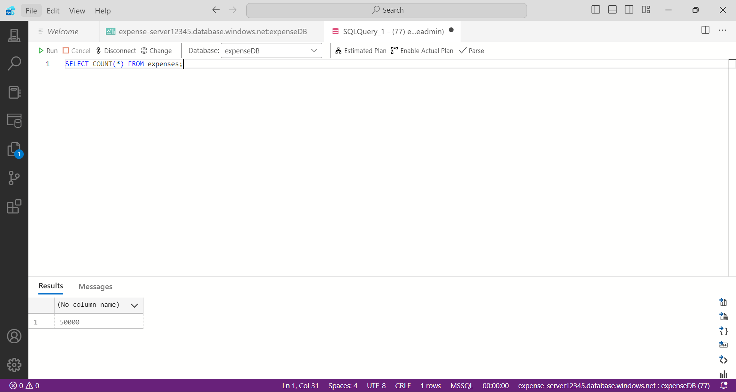
Expense data Retrieval and Verification using Sql

Slide 9
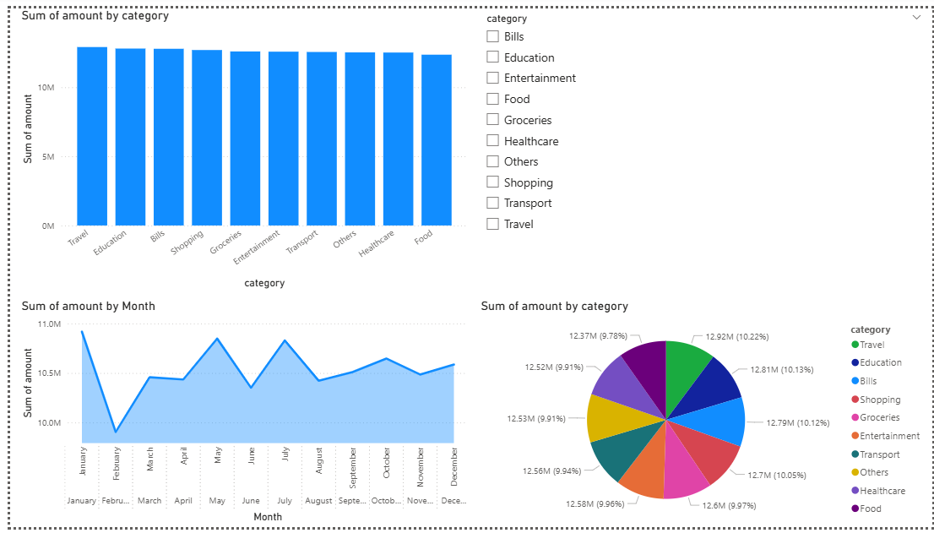
Expense Data Visualization Dashboard

Slide 10
Web application Overview:
The system is implemented as a user-friendly web application where users can easily enter and manage their daily expenses. The website provides a simple interface for adding expense details such as date, category, amount, and payment mode. It ensures smooth interaction between the user and the backend system.

Slide 11
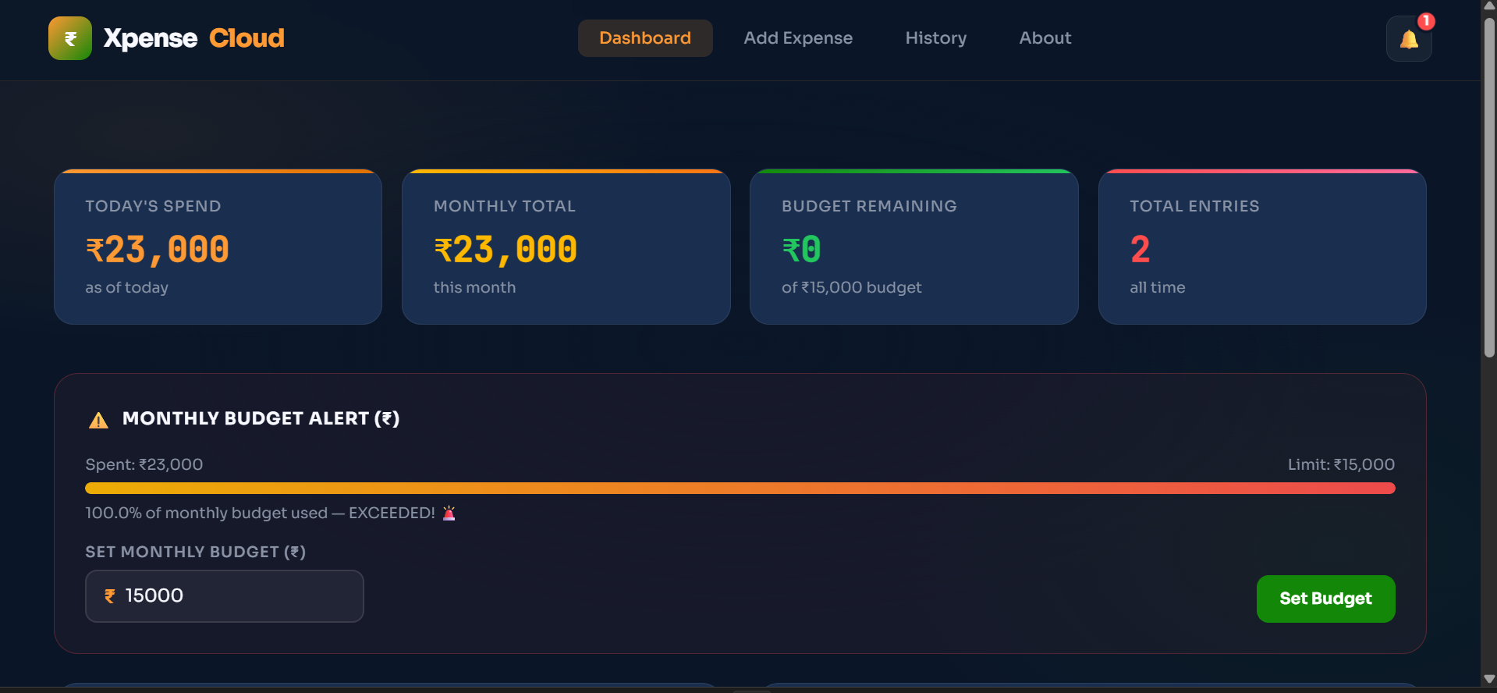
Dashboard of the Website

Slide 12
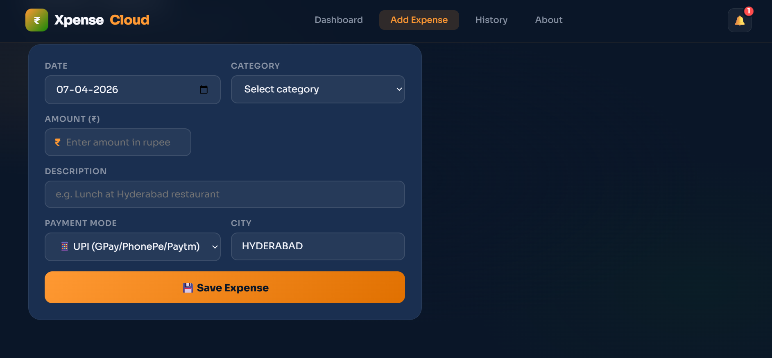
We can add Expenses here

Slide 13
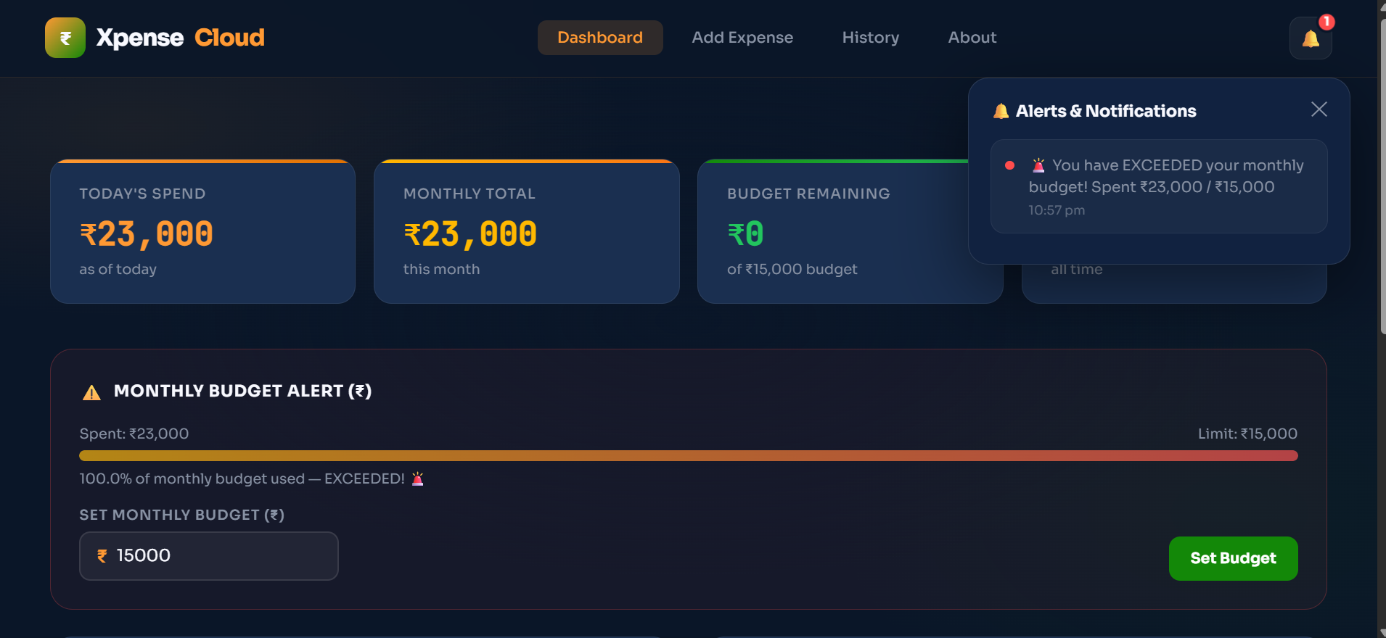
The system includes a smart notification feature that alerts users when their monthly budget limit is exceeded. This helps users stay aware of their spending habits and avoid overspending.

Slide 14
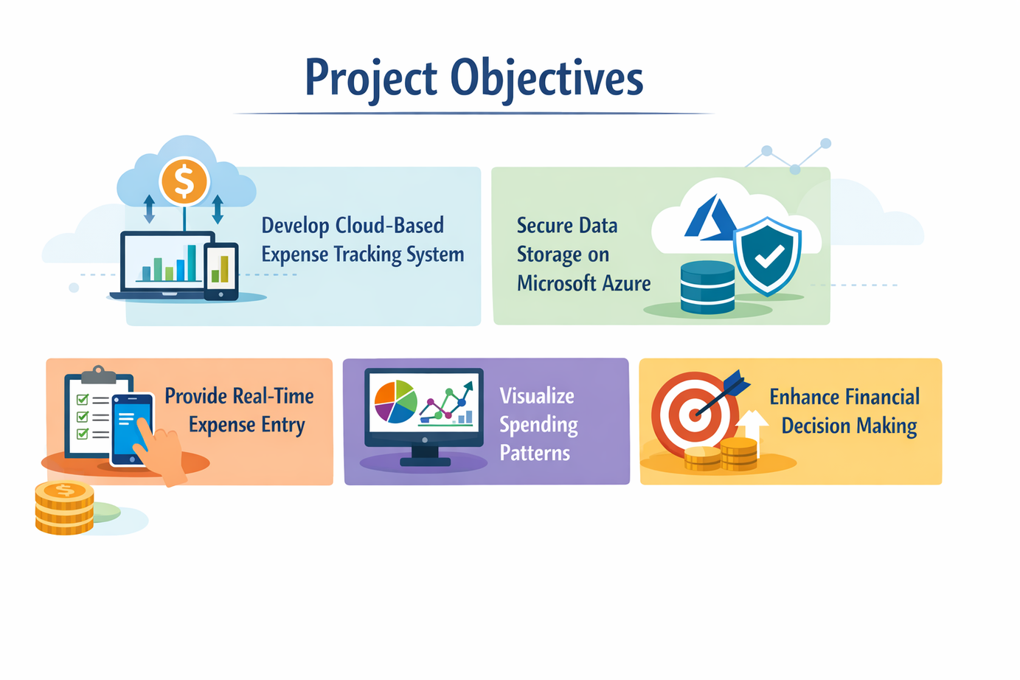
Final Outcome
A fully functional cloud-based expense tracking system.
Secure storage of daily expense data using Microsoft Azure.
Real-time visualization of spending through interactive dashboards.
Clear insights into daily, monthly, and category-wise expenses.
Improved financial awareness and better decision-making for users.

Slide 15
Conclusion
This project develops a cloud-based system to track and visualize daily expenses using Microsoft Azure and Power BI. It provides secure storage, real-time insights, and clear visual analysis of spending patterns. Overall, it simplifies financial management and supports better decision-making.

Slide 16
Thank you

